Slide 1
August 1st
Ainsley Lai

Slide 2
Agenda
Checking for filtering in audio band when calculating Rx level
Speed & Rx level vs. Range
Speed vs. Range plots were previously incorrect, both had been sorted to be ascending
Range, Speed, Rx vs. Time
Relation between speed and Rx level in literature

Slide 3

Rx Level Calculation
Loads in MSEED (audio) data
Take FFT of audio
Center frequency on zero, take 5-90 Hz values
Calculate sound exposure using equation
Convert to dB
Save as Rx level
Only filtering is freq. selection
5-90 Hz

Slide 4
Plots

Slide 5
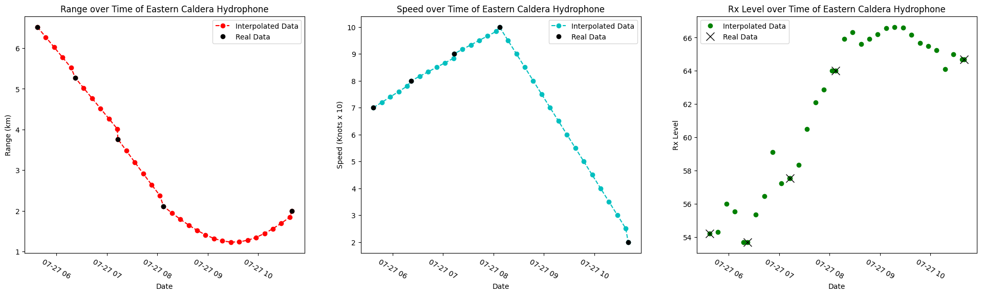
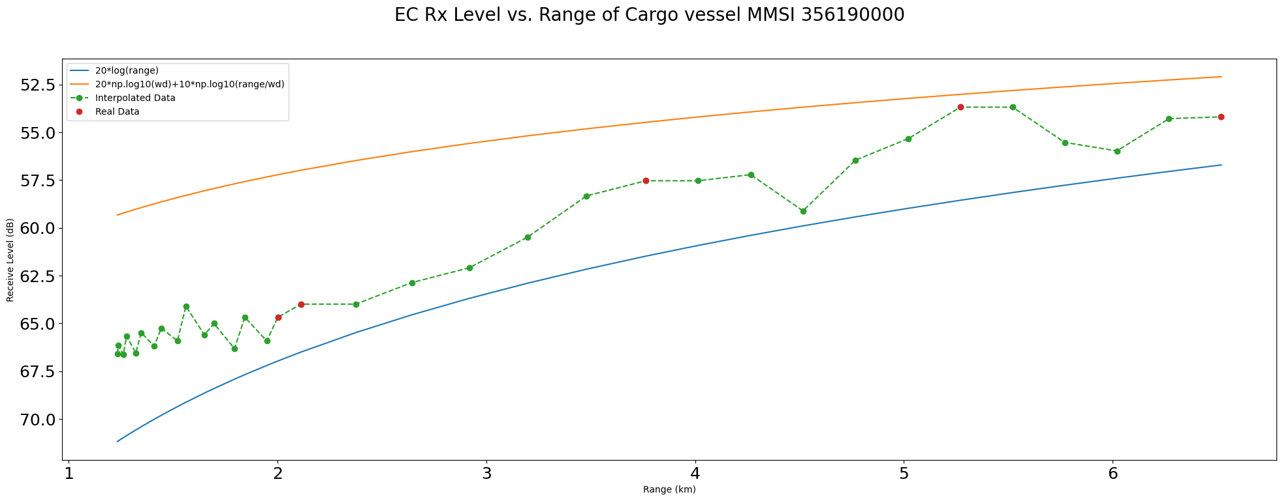
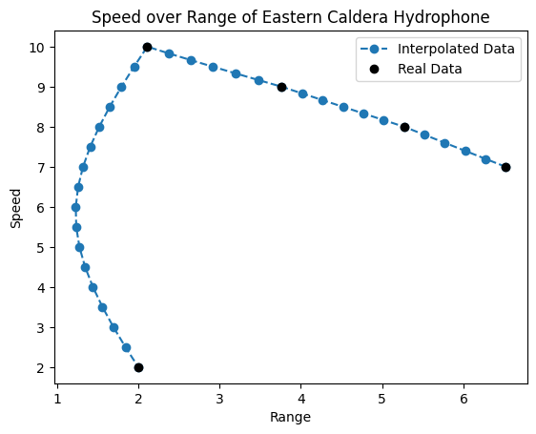
Eastern Caldera

Slide 6
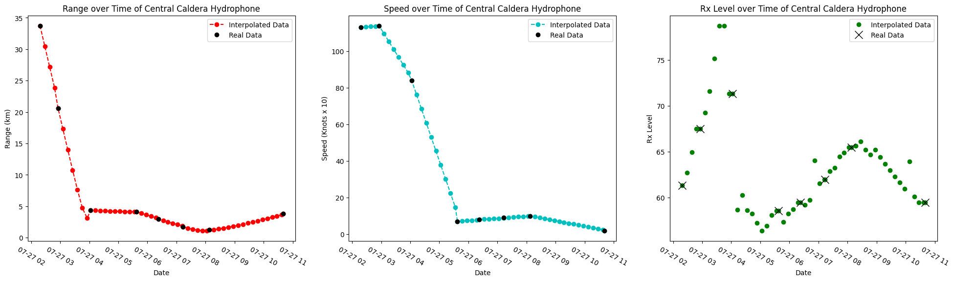
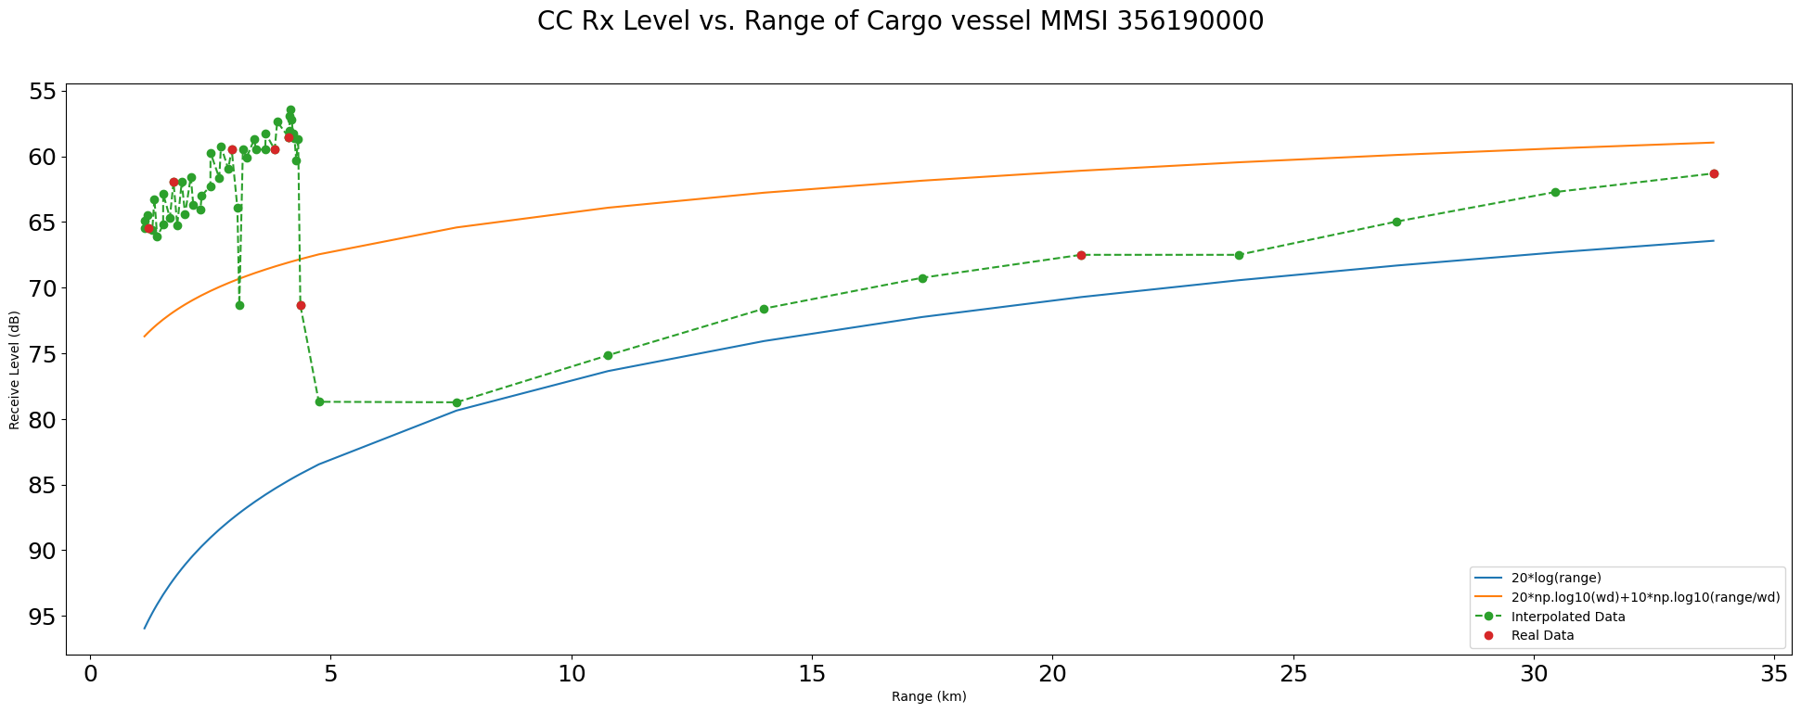
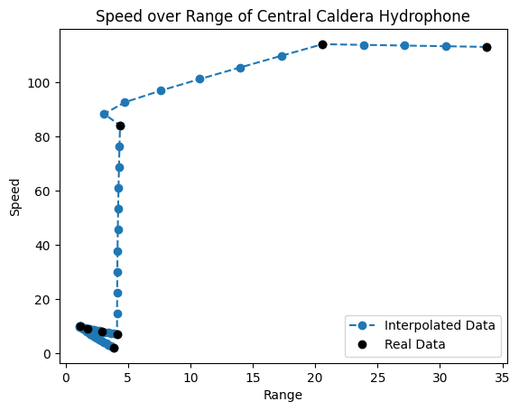
Central Caldera

Slide 7
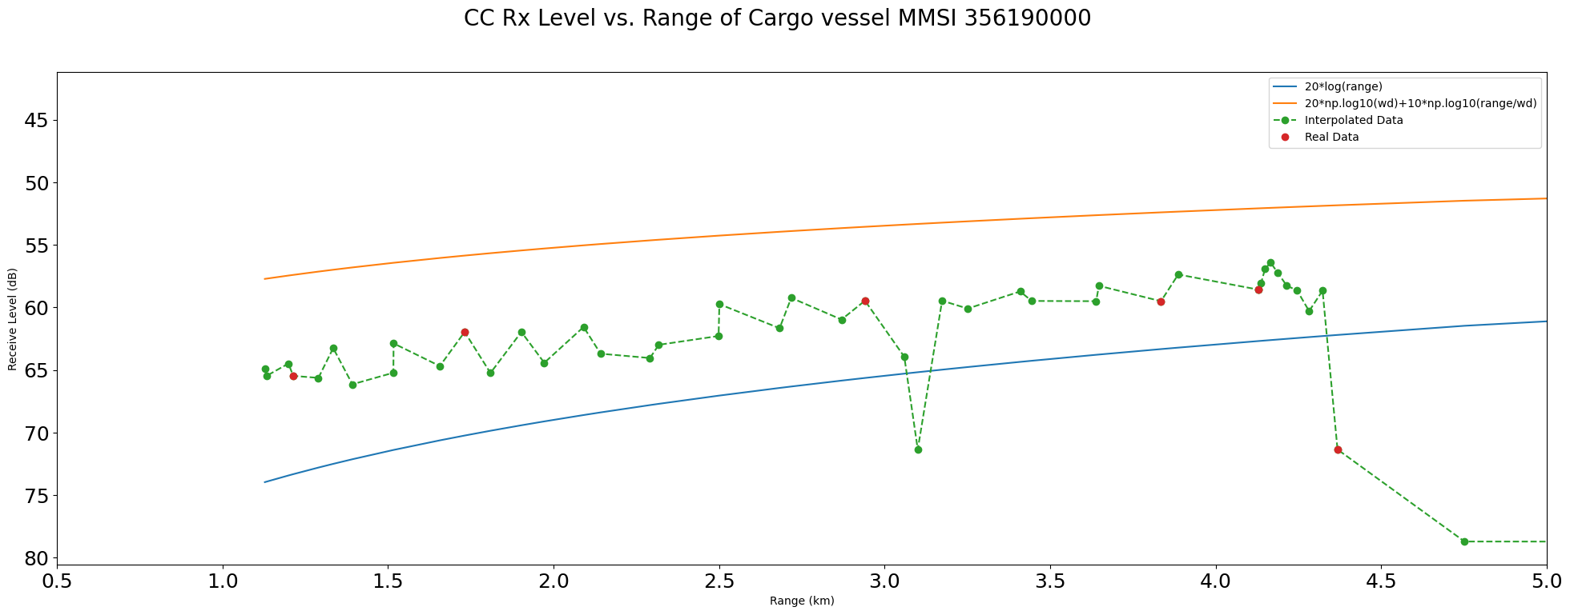
Central Caldera

Slide 9
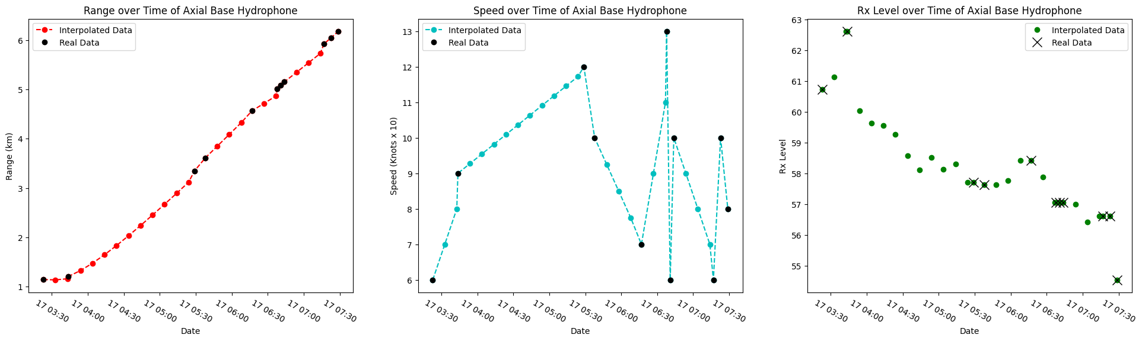
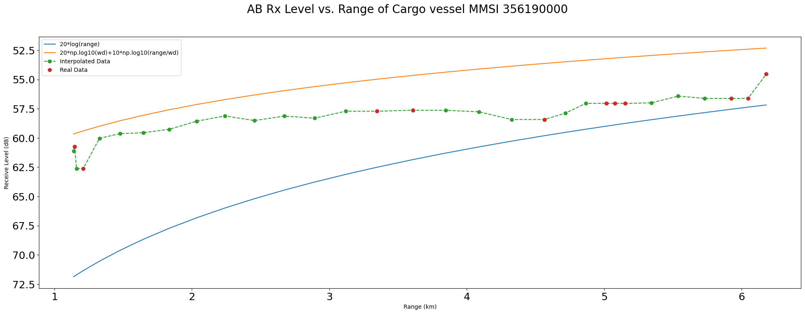
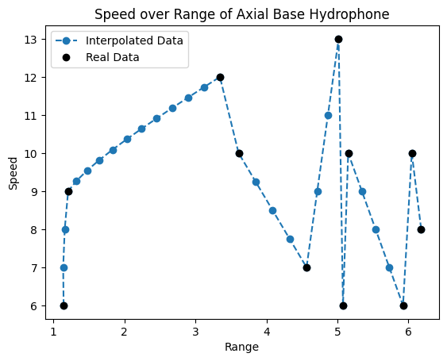
Axial Base

Slide 10
Literature

